Slide 1
MSDM 5003 Week 11 9 November 2021 The Wealth Game
Outline:
11.1 Phases in the Minority Game
11.2 The Wealth Game
11.3 Testing with Hang Seng Index

Slide 2
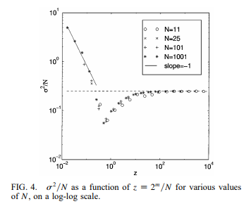
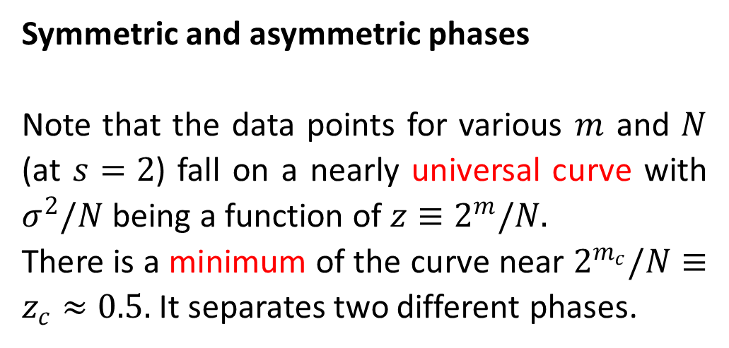
11.1 Phases in the Minority Game⁵
Symmetric and asymmetric phases
Note that the data points for various $m$ and $N$ (at $s=2$) fall on a nearly universal curve with $σ^{2}/N$ being a function of $z≡2^{m}/N.$
There is a minimum of the curve near $2^{m_{c}}/N≡z_{c}≈0.5.$ It separates two different phases.
⁵ Savit R, Manuca R, and Riolo R (1999) Adaptive competition, market efficiency, and phase transitions. Phys Rev Lett 82 2203-2206

Slide 3
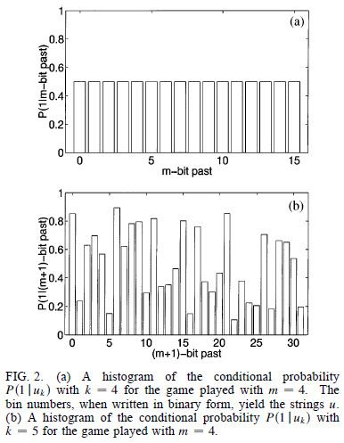
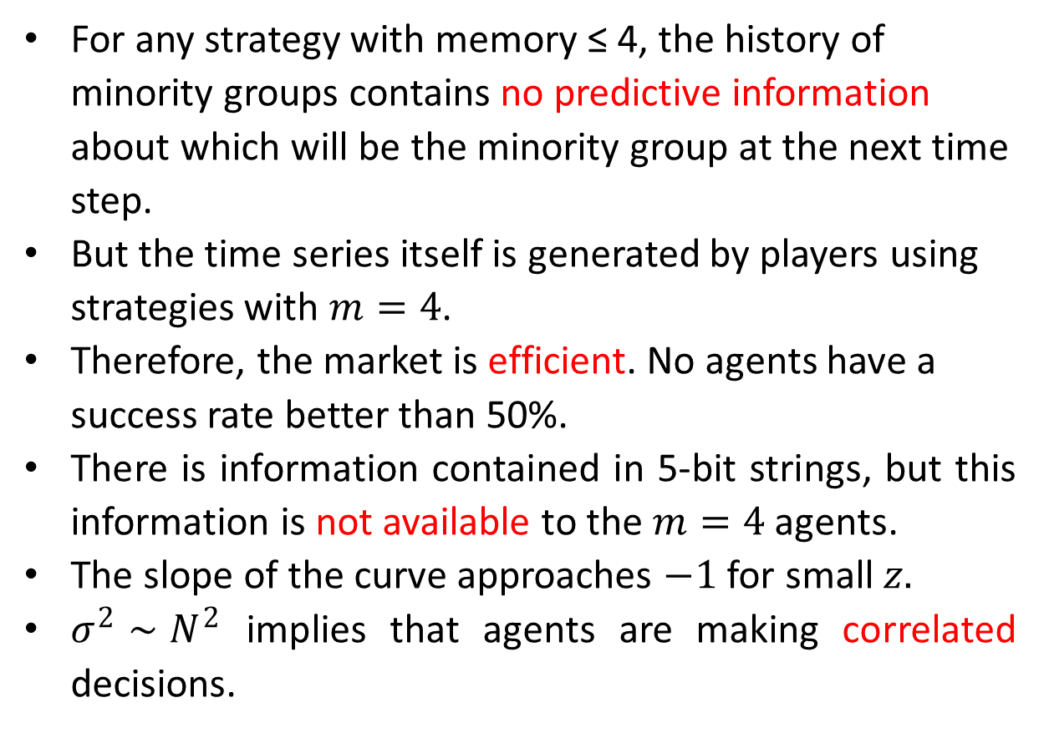
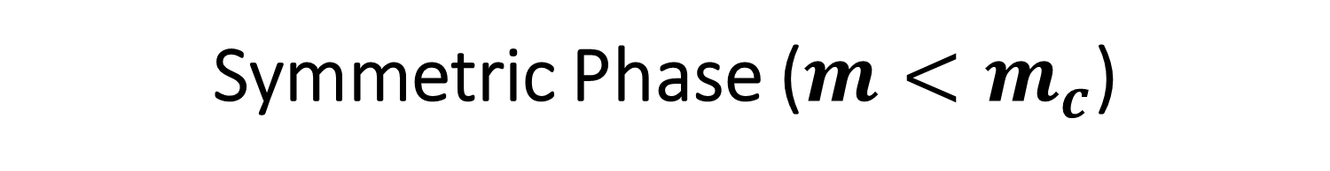
Symmetric Phase ($m<m_{c}$)
For any strategy with memory ≤ 4, the history of minority groups contains no predictive information about which will be the minority group at the next time step.
But the time series itself is generated by players using strategies with $m=4$.
Therefore, the market is efficient. No agents have a success rate better than 50%.
There is information contained in 5-bit strings, but this information is not available to the $m=4$ agents.
The slope of the curve approaches $−1$ for small $z.$
$σ^{2}∼N^{2}$ implies that agents are making correlated decisions.

Slide 4
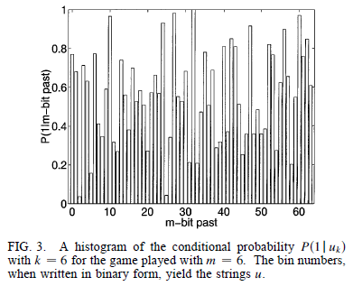
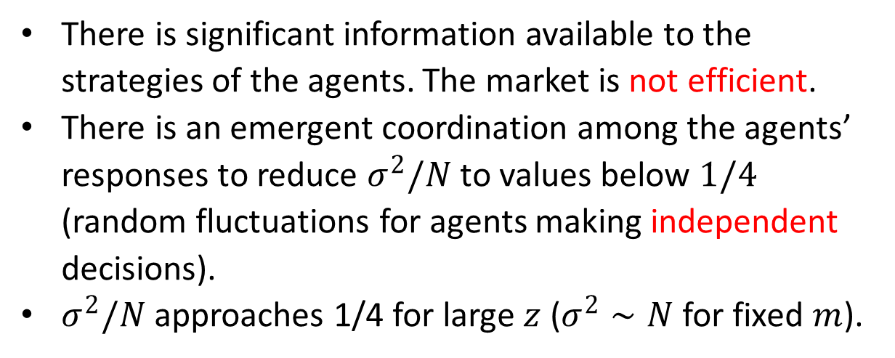
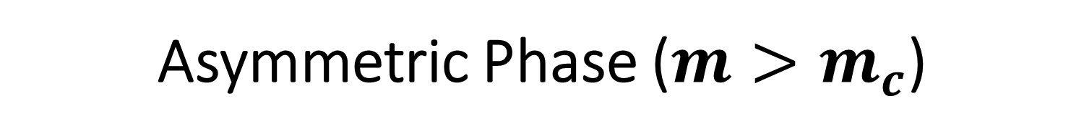
Asymmetric Phase ($m>m_{c}$)
There is significant information available to the strategies of the agents. The market is not efficient.
There is an emergent coordination among the agents’ responses to reduce $σ^{2}/N$ to values below $1/4$ (random fluctuations for agents making independent decisions).
$σ^{2}/N$ approaches 1/4 for large $z$ ($σ^{2}∼N$ for fixed $m$).

Slide 5
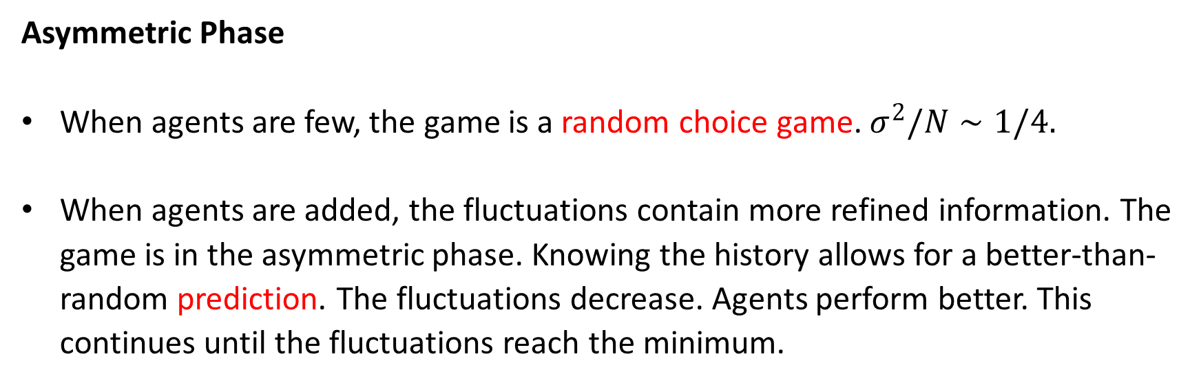
Perspective from Growing Population (1)
Asymmetric Phase
When agents are few, the game is a random choice game. $σ^{2}/N∼1/4.$
When agents are added, the fluctuations contain more refined information. The game is in the asymmetric phase. Knowing the history allows for a better-than-random prediction. The fluctuations decrease. Agents perform better. This continues until the fluctuations reach the minimum.

Slide 6
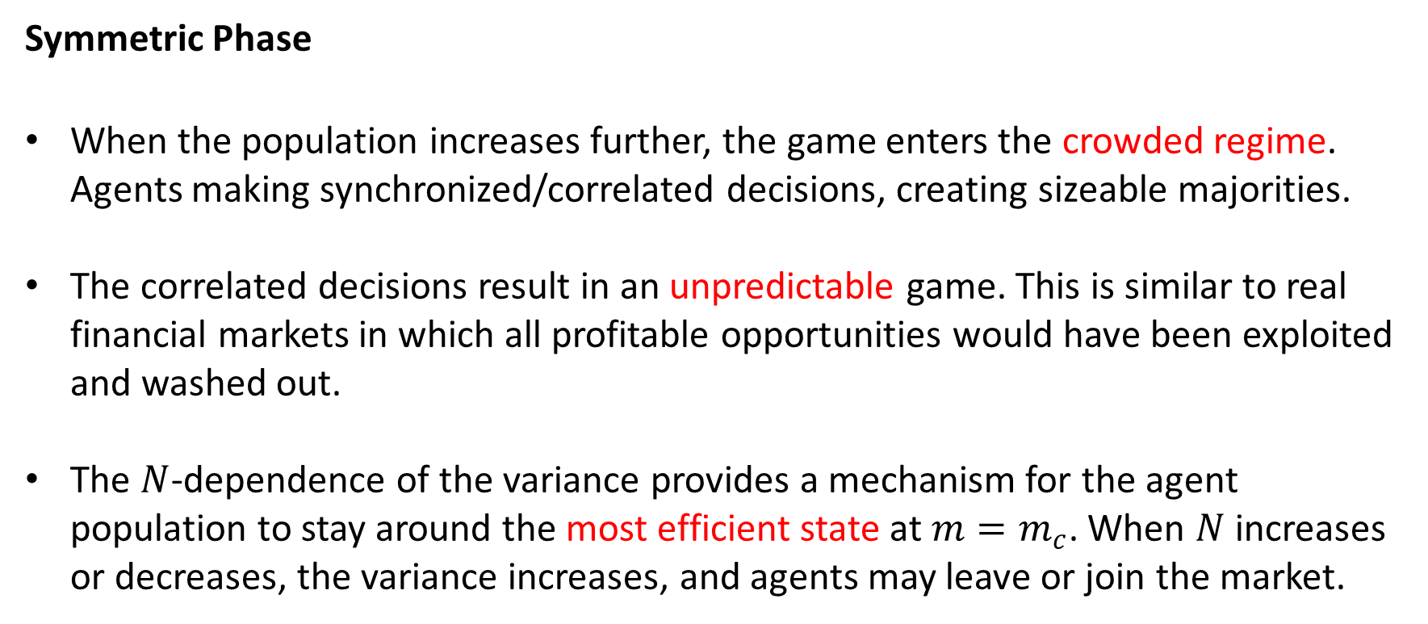
Perspective from Growing Population (2)
Symmetric Phase
When the population increases further, the game enters the crowded regime. Agents making synchronized/correlated decisions, creating sizeable majorities.
The correlated decisions result in an unpredictable game. This is similar to real financial markets in which all profitable opportunities would have been exploited and washed out.
The $N$-dependence of the variance provides a mechanism for the agent population to stay around the most efficient state at $m=m_{c}$. When $N$ increases or decreases, the variance increases, and agents may leave or join the market.

Slide 7
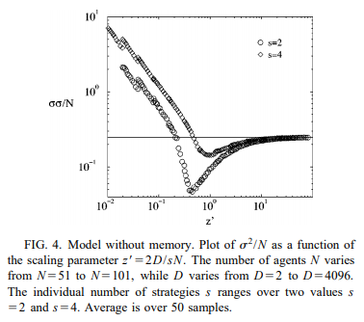
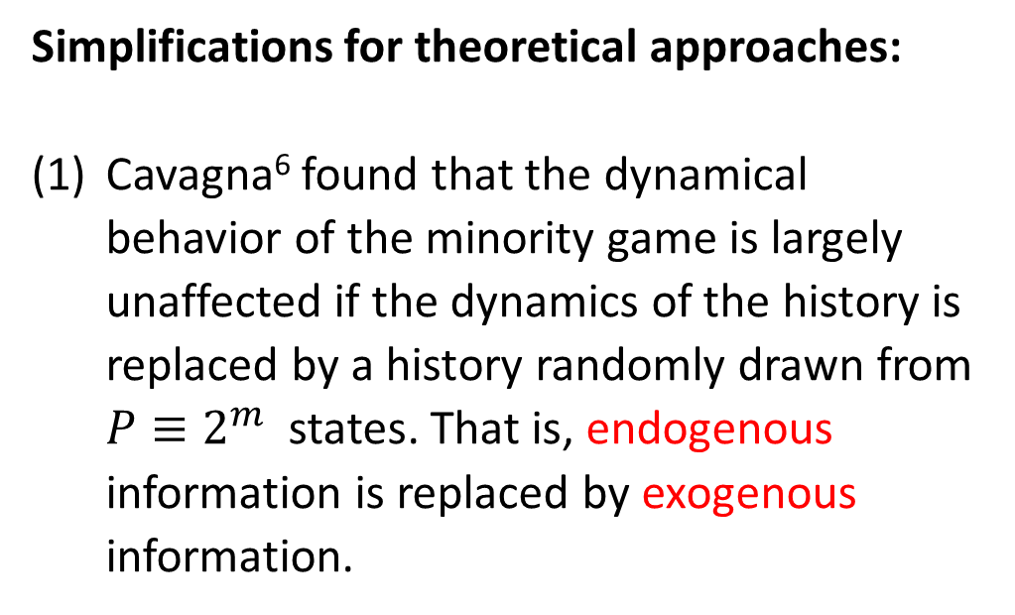
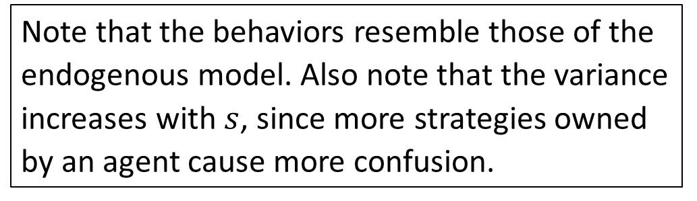
Theoretical approaches to the Minority Game
Simplifications for theoretical approaches:
Cavagna⁶ found that the dynamical behavior of the minority game is largely unaffected if the dynamics of the history is replaced by a history randomly drawn from $P≡2^{m}$ states. That is, endogenous information is replaced by exogenous information.
Note that the behaviors resemble those of the endogenous model. Also note that the variance increases with $s$, since more strategies owned by an agent cause more confusion.
⁶ Cavagna A (1999) Irrelevance of memory in the minority game. Phys Rev E 59 R3783-R3786.

Slide 8
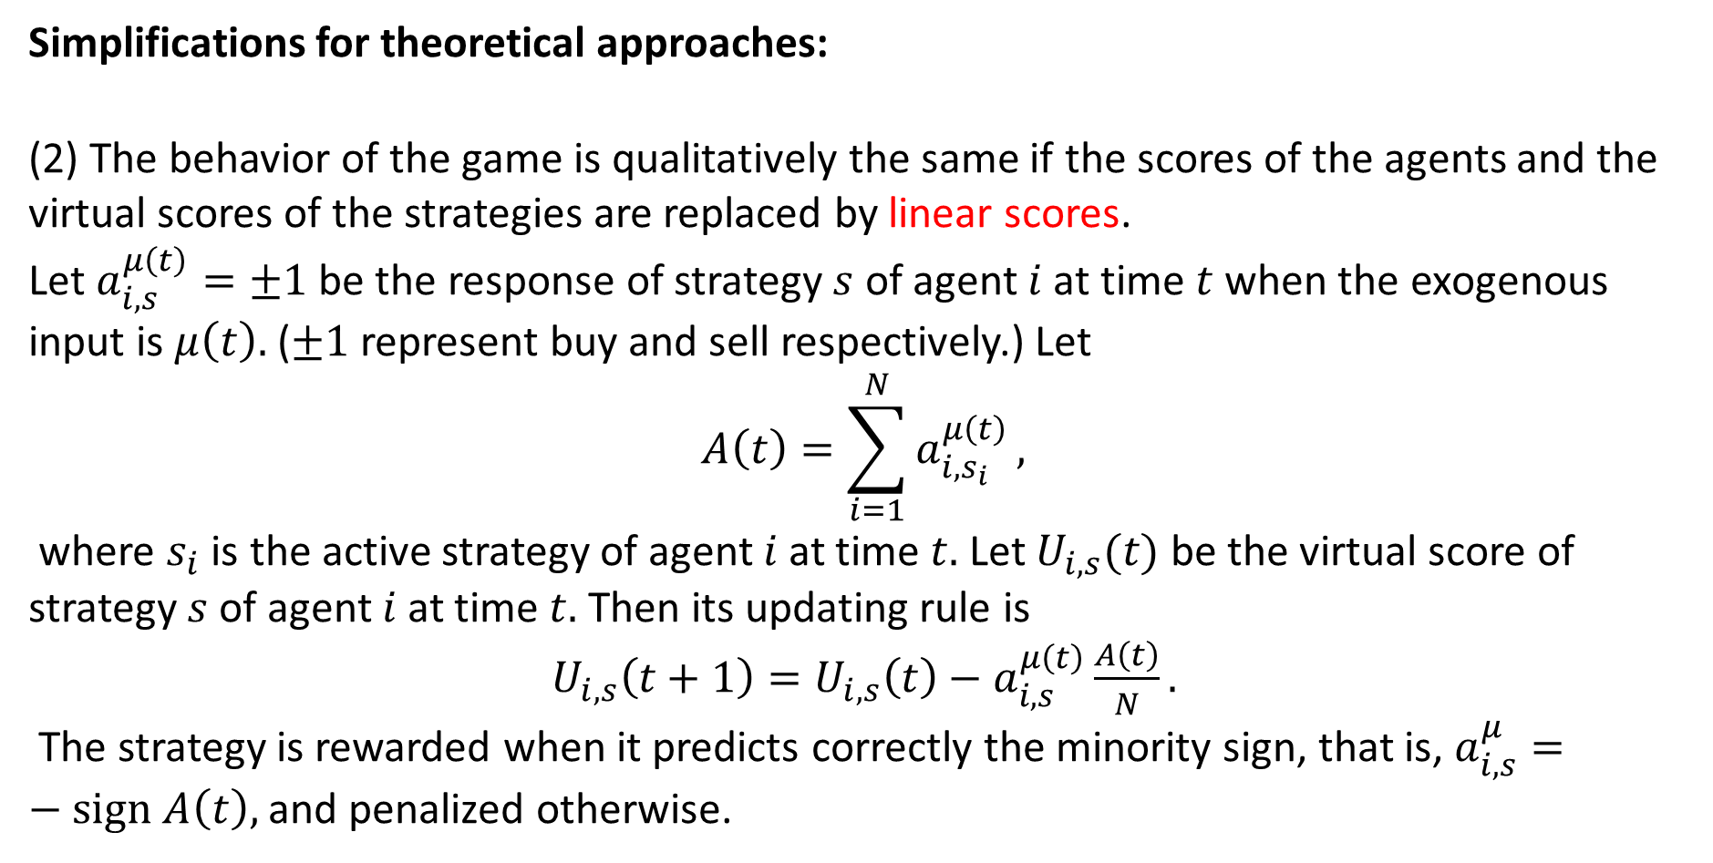
Linear Scores
Simplifications for theoretical approaches:
(2) The behavior of the game is qualitatively the same if the scores of the agents and the virtual scores of the strategies are replaced by linear scores.
Let $a_{i,s}^{μ\left(t\right)}=±1$ be the response of strategy $s$ of agent $i$ at time $t$ when the exogenous input is $μ\left(t\right).$ ($±1$ represent buy and sell respectively.) Let
$$A\left(t\right)=\sum_{i=1}^{N}{a_{i,s_{i}}^{μ\left(t\right)}},$$
where $s_{i}$ is the active strategy of agent $i$ at time $t.$ Let $U_{i,s}(t)$ be the virtual score of strategy $s$ of agent $i$ at time $t.$ Then its updating rule is
$U_{i,s}\left(t+1\right)=U_{i,s}\left(t\right)−a_{i,s}^{μ\left(t\right)}\frac{A\left(t\right)}{N}.$
The strategy is rewarded when it predicts correctly the minority sign, that is, $a_{i,s}^{μ}=−sign A\left(t\right),$ and penalized otherwise.

Slide 9
Linear Scores
Simplifications for theoretical approaches:
(2) The behavior of the game is qualitatively the same if the scores of the agents and the virtual scores of the strategies are replaced by linear scores.
Let $a_{i,s}^{μ\left(t\right)}=±1$ be the response of strategy $s$ of agent $i$ at time $t$ when the exogenous input is $μ\left(t\right).$ ($±1$ represent buy and sell respectively.) Let
$$A\left(t\right)=\sum_{i=1}^{N}{a_{i,s_{i}}^{μ\left(t\right)}},$$
where $s_{i}$ is the active strategy of agent $i$ at time $t.$ Let $U_{i,s}(t)$ be the virtual score of strategy $s$ of agent $i$ at time $t.$ Then its updating rule is
$U_{i,s}\left(t+1\right)=U_{i,s}\left(t\right)−a_{i,s}^{μ\left(t\right)}\frac{A\left(t\right)}{N}.$
The strategy is rewarded when it predicts correctly the minority sign, that is, $a_{i,s}^{μ}=−sign A\left(t\right),$ and penalized otherwise.

Slide 10
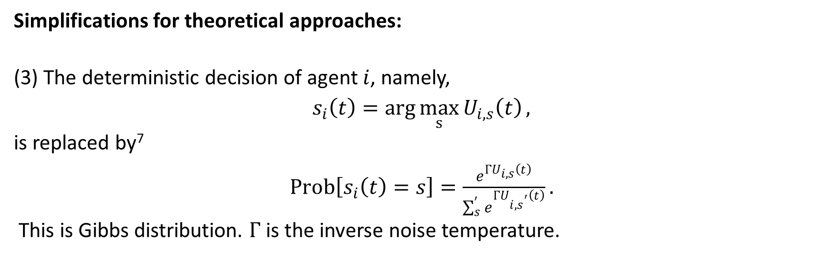
Adding Noises
Simplifications for theoretical approaches:
(3) The deterministic decision of agent $i$, namely,
$s_{i}\left(t\right)=\arg{\max_{s}{U_{i,s}\left(t\right)}},$
is replaced by⁷
$Prob\left[s_{i}\left(t\right)=s\right]=\frac{e^{ΓU_{i,s}\left(t\right)}}{\sum_{s}^{′}{e^{ΓU_{i,s^{′}}\left(t\right)}}}.$
This is Gibbs distribution. $Γ$ is the inverse noise temperature.
⁷ Cavagna A, Garrahan J, Giardina I, and Sherrington D (1999) Thermal model for adaptive competition in a market. Phys Rev Lett 83 4429-4432.

Slide 11
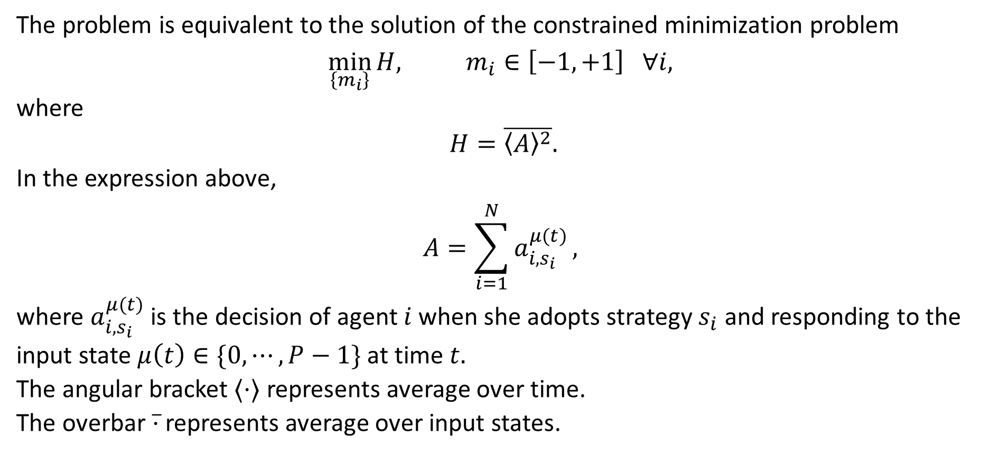
Minority Game as a Minimization Problem⁸
The problem is equivalent to the solution of the constrained minimization problem
$$\min_{\left\{m_{i}\right\}}{H, m_{i}∈\left[−1,+1\right] ∀i,}$$
where
$H=\overline{{〈A〉}^{2}}.$
In the expression above,
$$A=\sum_{i=1}^{N}{a_{i,s_{i}}^{μ(t)}},$$
where $a_{i,s_{i}}^{μ(t)}$ is the decision of agent $i$ when she adopts strategy $s_{i}$ and responding to the input state $μ\left(t\right)∈\{0,⋯,P−1\}$ at time $t.$
The angular bracket $⟨⋅⟩$ represents average over time.
The overbar $\overline{⋅}$ represents average over input states.
⁸ Challet D, Marsili M, and Zecchina R (2000) Statistical mechanics of systems with heterogeneous agetns: minority games. Phys Rev Lett 84 1824-1827.

Slide 12
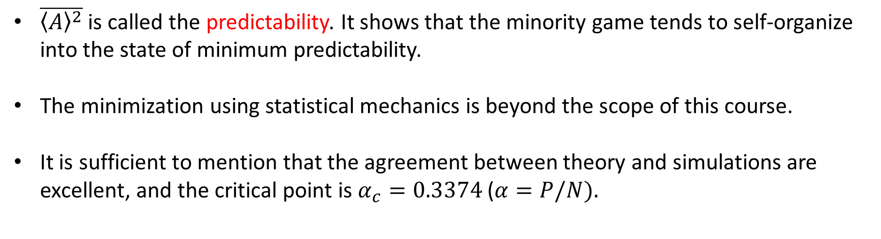
Predictability
$\overline{{〈A〉}^{2}}$ is called the predictability. It shows that the minority game tends to self-organize into the state of minimum predictability.
The minimization using statistical mechanics is beyond the scope of this course.
It is sufficient to mention that the agreement between theory and simulations are excellent, and the critical point is $α_{c}=0.3374$ ($α=P/N).$

Slide 13
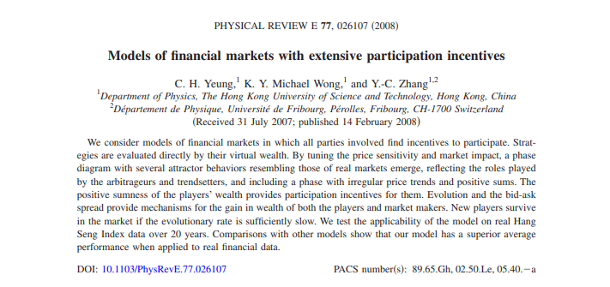
11.2 The Wealth Game
C. H. Yeung (楊志豪)¹
K. Y. Michael Wong (王國彝)¹
Y. C. Zhang (張翼成)^{1,2}
¹HKUST, ²Université de Fribourg

Slide 14
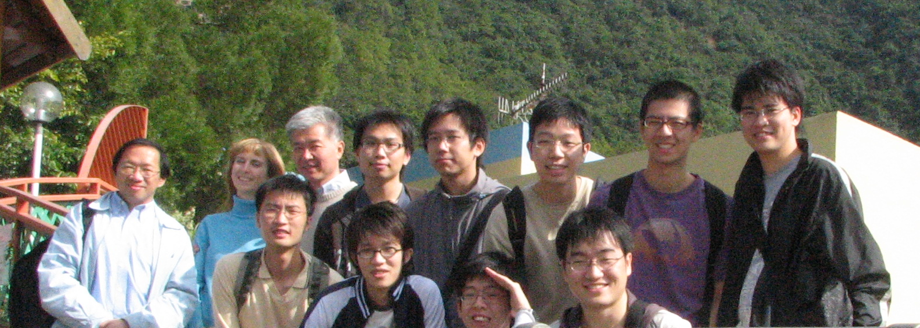
Group Outing, 1 January 2007
Zhang
Wong
Yeung

Slide 15
Introduction
The issue of participation incentives
Wealth-based payoff scheme
Phase diagram
Market-makers
Evolving markets
Tests with Hang Seng Index

Slide 16
Participation Incentives
In financial markets, the minority wins.
If there are more buyers than sellers, the sellers win, and vice versa.
The Minority Game (MG) is an agent-based model successfully applied to financial markets.
Since MG is a negative-sum game, it cannot explain why agents have participation incentives.

Slide 17



Market Modeling: Agents
There are N agents in the market.
At every time step, each agent makes a decision to buy, sell or hold.
An agent follows one of her strategies to make decisions.
She chooses the strategy with the highest payoff among those she owns.

Slide 18
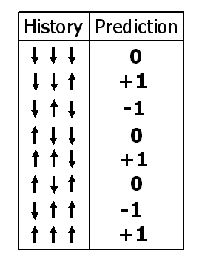
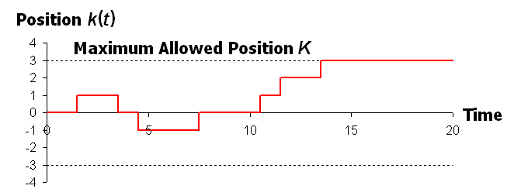
Strategies and Maximum Positions
A strategy prescribes an action given the previous price movement.
All strategies have at least one buy and sell decisions.
History
Action

Slide 19


Market Modeling: Payoffs
Individual decisions
Collective actions
Price
changes!!
Price rises/falls when the sellers/buyers are the minority.
Payoffs are updated according to price changes.
In MG, the payoff of a strategy changes by ±(price change) for sell/buy decisions (neutral to hold decisions).

Slide 20
Wealth-based Payoff
The payoff of MG is myopic:
only considers one-step effects
neglects historical effects of previous decisions
For example, it is neutral to hold decisions:
Holding a long position when price rises is good.
Holding a short position when price falls is good.
Proposed wealth-based payoff scheme: the payoff of a strategy = total wealth (cash + stock) it brings were its decisions followed in the market history.

Slide 21
Price Sensitivity
Price Sensitivity
Sensitivity of stock price on agents’ collective actions
Define γ :
Price
change
Individual decisions
Collective actions
Price movement = (Collective actions)^{γ}

Slide 22



Market Impact
Market impact: The impact of synchronized decisions from peer investors during transaction
Define β
Market
impact !!
Synchronized
Actions !!
Transaction price
= Current price
+ β (Synchronized price movement)

Slide 23
(1) Price sensitivity γ
Price movement = (Collective actions)^{γ}
(2) Market Impact β
Transaction price
= Current price
+ β (Synchronized price movement)
The 2 aspects we would like to put in the model !!

Slide 24
Decision of agent a_{i}(t) = +1, 0, −1
Real Price:
Transaction Price P_{T}(t)
= Price in between P(t+1) and P(t)
Collective
actions !!
Price
Sensitivity!!
Market Impact !!

Slide 25
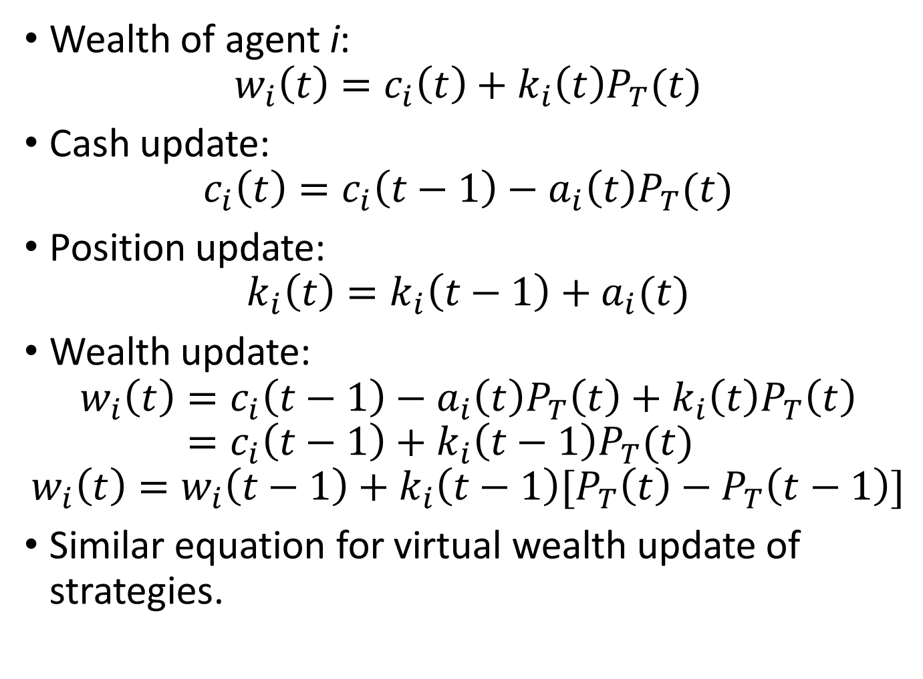
Wealth of agent i:
$$w_{i}\left(t\right)=c_{i}\left(t\right)+k_{i}\left(t\right)P_{T}(t)$$
Cash update:
$$c_{i}\left(t\right)=c_{i}\left(t−1\right)−a_{i}\left(t\right)P_{T}(t)$$
Position update:
$$k_{i}\left(t\right)=k_{i}\left(t−1\right)+a_{i}(t)$$
Wealth update:
$$w_{i}\left(t\right)=c_{i}\left(t−1\right)−a_{i}\left(t\right)P_{T}\left(t\right)+k_{i}\left(t\right)P_{T}\left(t\right)$$
$$=c_{i}\left(t−1\right)+k_{i}\left(t−1\right)P_{T}(t)$$
$$w_{i}\left(t\right)=w_{i}\left(t−1\right)+k_{i}\left(t−1\right)[P_{T}\left(t\right)−P_{T}\left(t−1\right)]$$
Similar equation for virtual wealth update of strategies.

Slide 26
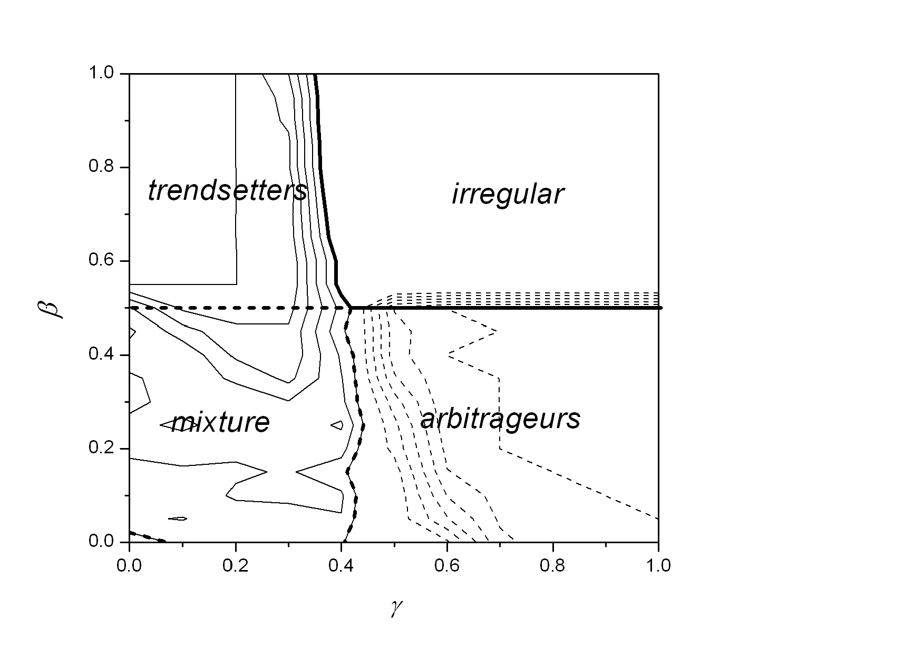
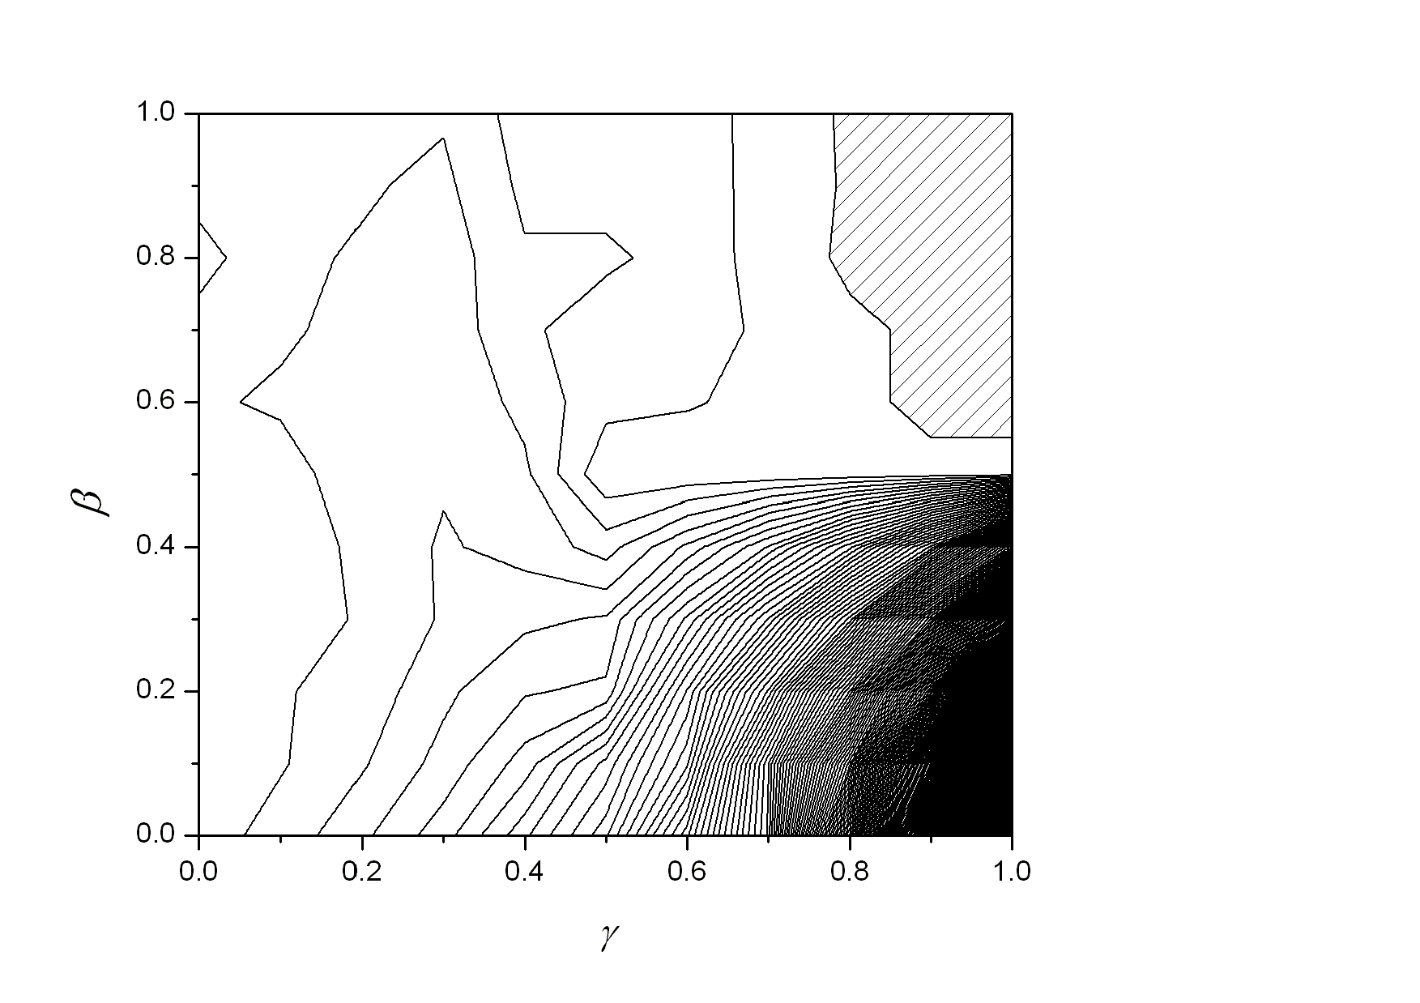
Results
Negative
Positive
Final State
of the system
Agents’ wealth

Slide 27
Irregular phase ??
Trendsetters’ phase ??
Phase Diagram of
Final State
Mixture phase ??
Arbitrageurs’ phase ??

Slide 28
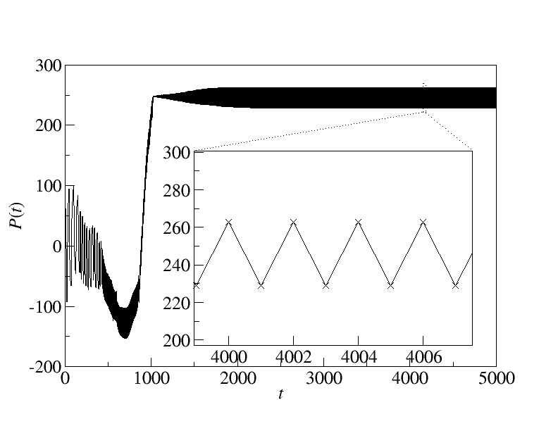
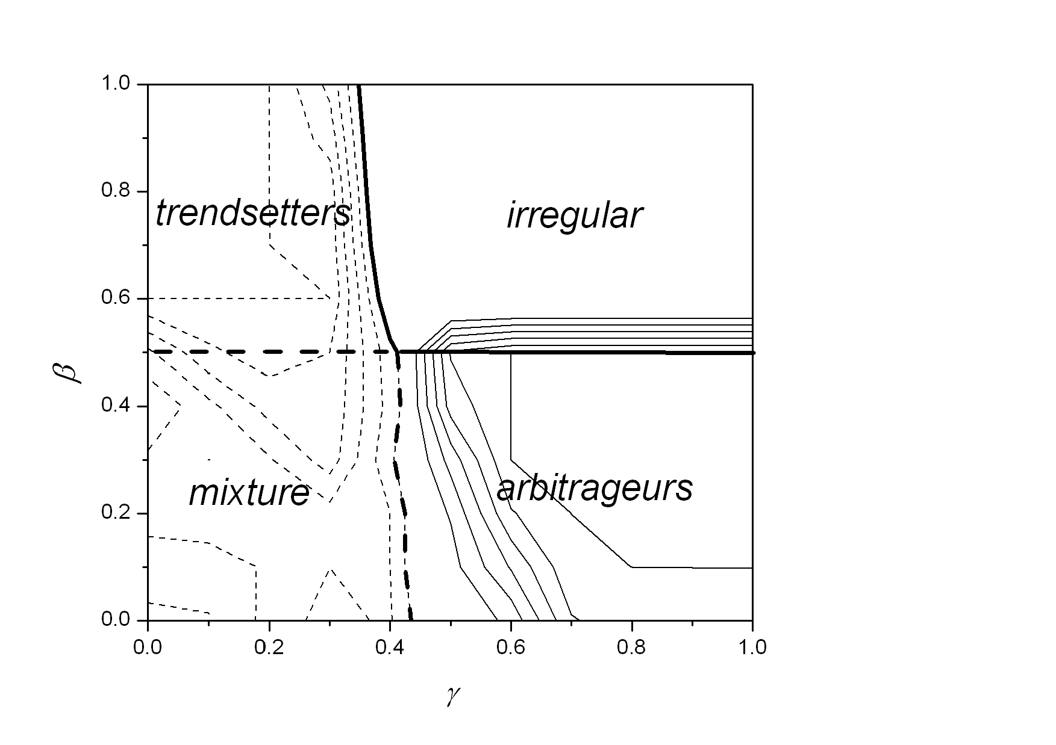
Arbitrageurs’ Phase
sell!
buy!
For β ≤ 0.5 ⇒
Period-2 cycle for P(t) !?
Gain!!

Slide 29
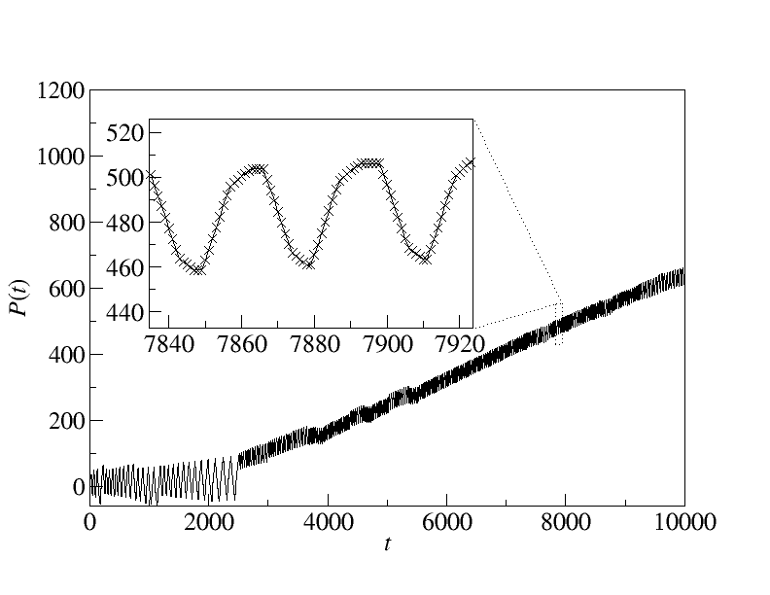
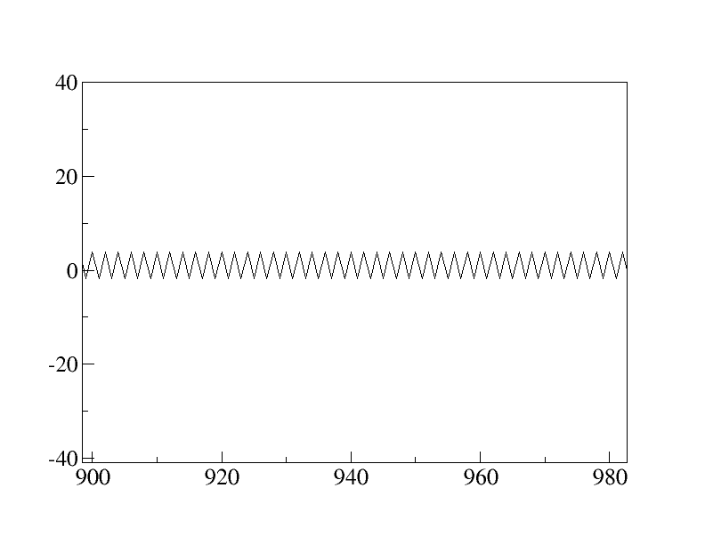
Trendsetters’ Phase
What are
they doing?
Periodic with characteristic pattern
Period much longer than period 2 !!
VS
Arbitrageurs’ phase

Slide 30

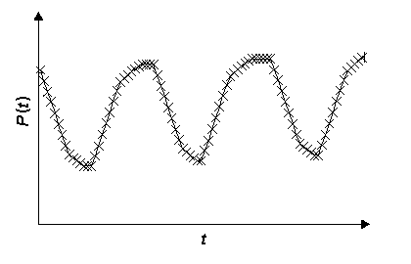

Trendsetter state
Trendsetters
(winners)
Trendfollowers
(winners)
Late followers
(losers)
Start to sell !!
(Set up the downward trend)
Follow the trend !!
I am late...
We didn’t teach them to set up and follow trend !!
But they do it !!!

Slide 31
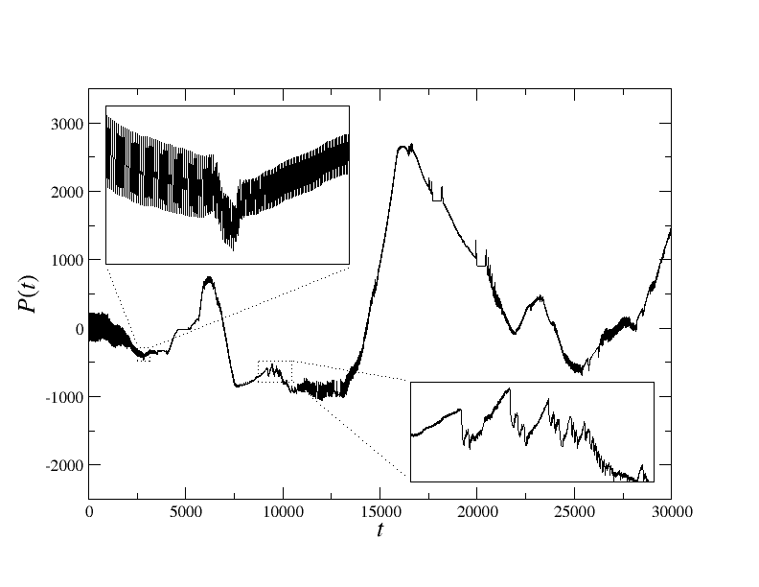
Irregular Phase
Short time fluctuations embedded in long time fluctuations.
Fat tail distributions of price change.

Slide 32
Which Part of the Phase Diagram Resembles Real Markets Most?
Agent’s wealth
Negative
Positive

Slide 33
11.3 Testing with Hang Seng Index
Interest rates
Asian crisis
Gulf War
June 4th
Black Monday
Recovery
SARS
911 attack
1987
2007
Dot-com bubble

Slide 34
Comparison
 | Payoff update
Wealth Game | last position × trans. price change
Minority Game | −decision × price change
$-Game | decision × last price change
Majority Game | decision × price change
Decision: +1 for buy, −1 for sell

Slide 35
Tests with Fixed Maximum Position
Wealth Game has the best average wealth.

Slide 36
An Interesting Twist
 | Wealth Game | Minority Game | $-Game | Majority Game
Average wealth | 0.6 | −0.12 | 0.03 | 0.08
Best wealth | 3.31 | 4.51 | 3.35 | 3.38
Wealth Game has the best average wealth.
Minority Game has the richest agents (sacrificing the performance of other agents).

Slide 37
Tests with Wealth-Based Max. Pos.
Initial wealth of all agents = 5 × HSI price
Maximum position of an agent
= current wealth / current HSI price (wealth > 0)
= 0 (wealth < 0)
An agent cannot buy/sell when her wealth falls below the current HSI price.

Slide 38
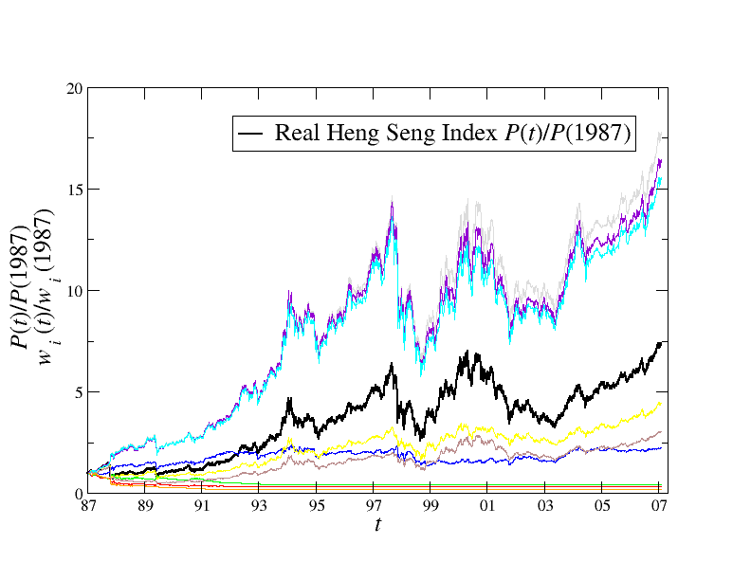
Results (HSI from 1987 – 2007)
Best 3
among
10000
Agents
x 17 times
HSI
x 7.5 times
5 random
agents
5 worst
agents

Slide 39
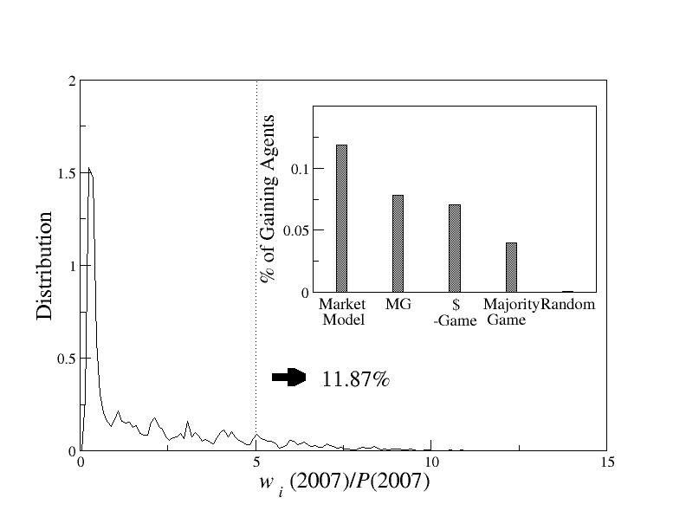
Comparison with other models: % of gaining agents
Wealth grows
slower than
inflation
Wealth grows
faster than
inflation
≈10%

Slide 40
Comparison
 | Wealth Game | Minority Game | $-Game | Majority Game
Average wealth | 1.85 | 1.47 | 1.40 | 1.31
% gaining agents | 10.4 | 8.68 | 6.40 | 5.45
Worst wealth | 0.13 | 0.13 | 0.13 | 0.12
Best wealth | 11.16 | 17.15 | 11.13 | 10.88

Slide 41
Relaxing Strategy Constraints
Suppose strategies no longer have to include at least one buy and sell decisions.
Then there will be more risks of an agent being trapped in a long/short position in a bearish/bullish market.
Bankruptcy rate = probability of wealth < 0

Slide 42
Distribution of Negative Wealth
Bankruptcy
Wealth game | 0.7
Minority Game | 4.7
$-Game | 2.6
Majority Game | 3.0

Slide 43
Trendy Period (2003-2007)

Slide 44
Trendy Period: Wealth Distribution

Slide 45
Trendy Period: Comparison
 | Wealth Game | Minority Game | $-Game | Majority Game
Average wealth | 2.82 | 2.03 | 2.48 | 2.49
% gaining agents | 0 | 0 | 0 | 0.001
Worst wealth | 0.88 | 0.88 | 0.87 | 0.87
% bankruptcy | 0 | 0 | 0 | 0
Best wealth | 4.38 | 4.42 | 4.43 | 5.01

Slide 46
Rugged Period (1996-2001)

Slide 47
Rugged Period: Wealth Distribution

Slide 48
Rugged Period: Comparison
 | Wealth Game | Minority Game | $-Game | Majority Game
Average wealth | 3.46 | 4.02 | 3.61 | 3.70
% gaining agents | 13.0 | 26.3 | 21.4 | 19.8
Worst wealth | 0.91 | 1.12 | 0.99 | 0.66
% bankruptcy | 0 | 0 | 0 | 0
Best wealth | 10.8 | 17.2 | 10.7 | 11.5

Slide 49
Overall Assessment
Wealth Game characteristics:
Faithfully represents wealth considerations in strategies
Have long memory due to its position dependence
Works better when history can guide
Works worse with trend reversals
Works better in long term investment than short term speculation

Slide 50
Conclusion
Wealth-based payoff scheme:
Arbitrageurs and trendsetters
Irregular price trends and positive sums
Participation incentives:
Old players: region of positive-sum in the phase space
Market-makers: adaptive bid-ask spread (skipped in this lecture)
New players: strategy pre-learning (skipped in this lecture)
Tests with HSI:
Wealth Game: best average performance
Minority Game: explore risky strategies

